Slide 1
ACM TURC 2018 Report

Slide 2
Features (not so serious)
So many organization take part in this event
So many people (especially authorities) come here
including the (vice?) chair of SIGMOD, the principal of our school, “the boss of SJTU OS mafia(self-proclaimed)” etc.
So many delicious foods here

Slide 3
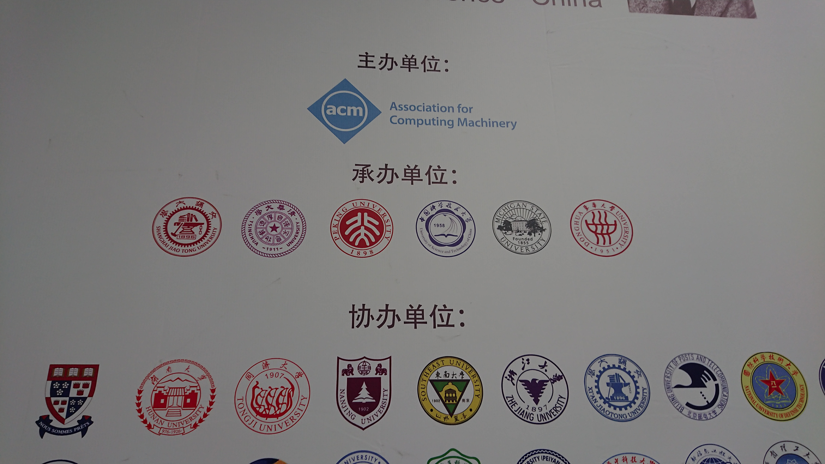
Our school comes the fourth of the country

Slide 4
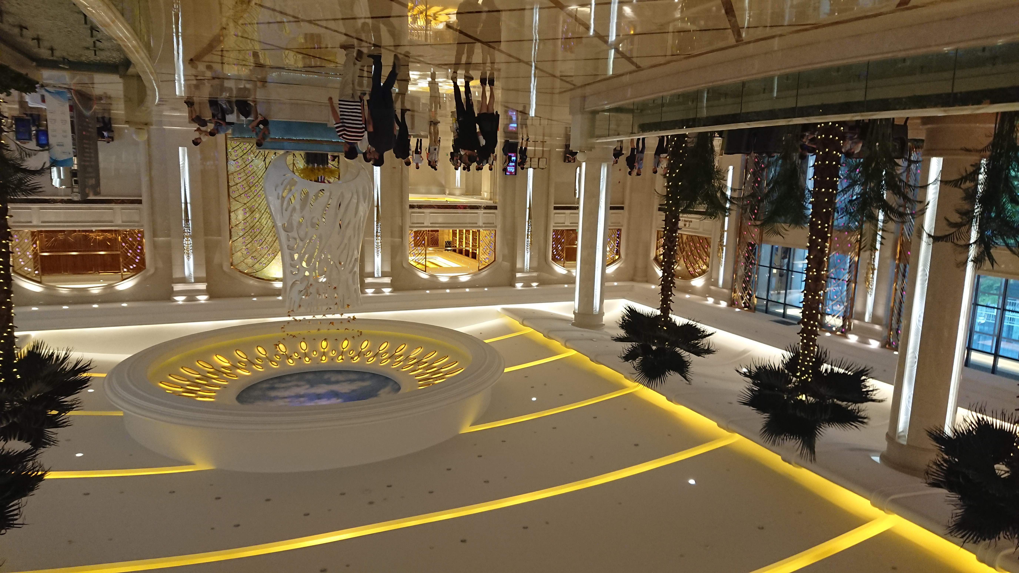
ACM committee is so rich

Slide 5
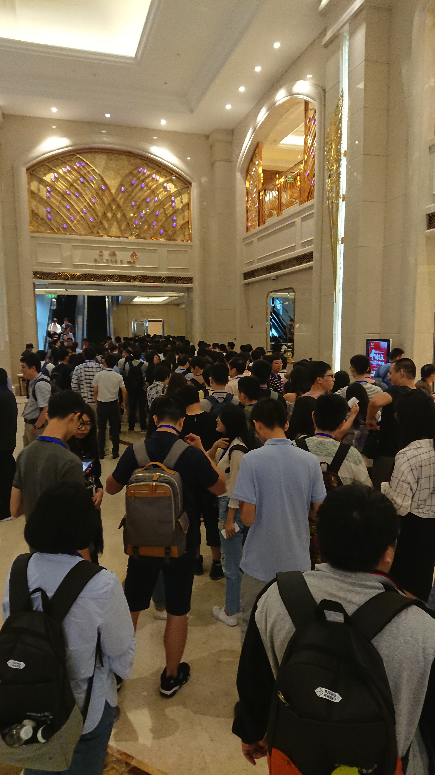
The queue waiting to break into the dining hall

Slide 6
Features
So many AI-relative works
So many OS / architecture works for big data applications on ChinaSys (SIGOPS China Symposium)
Almost all of them serve AI or AI serves them

Slide 7
GPU works
DCUDA: Dynamic GPU Sharing via Live Migration
Get Out of the Valley: Power-Efficient Address Mapping for GPUs
Accelerating the GPU Database Operations via a Data-driven Approach

Slide 8
OS works
寒武纪
X-Paxos: A global distributed consensus protocol library

Slide 9
DBMS works
Towards a Shared-Everything Database on Distributed Log-Structured Storage

Slide 10
Thinks

Slide 11
THX

